Slide 1
Anthropometric Measures Using DHS Data
Date/Title/Additional Information
Photo credit: Name/Organization

Slide 2
What Are Anthropometric Measures and Why are They Important?
Anthropometric measurements are non-invasive quantitative measurements that characterize body composition in size and shape. They are important indicators of nutritional status.
In 2016, undernutrition (stunting, wasting and underweight) was estimated to cause 1.0 million deaths, 3.9% of years of life lost, and 3.8% of disability-adjusted life years (DALYs) globally.
The Demographic Health Survey has collected this data since 1985, with height and weight data in 238 surveys in 77 countries from children and adults.

Slide 3
Anthropometry: Our Approach
Anthropometry data are not collected in the Zone of Influence (ZOI) Midline Surveys. Using the DHS to calculate the anthropometric indicators is suggested if the survey was implemented during a similar point in time.
There are two main steps to constructing anthropometric indicator estimates for the ZOI Midline Survey:
A geospatial overlay method can be implemented to locate the the DHS clusters inside of the ZOI. Once these clusters are identified as in or outside of the ZOI, individuals assigned to clusters outside the ZOI can be dropped.
The construction of anthropometric indicators can be carried out with the filtered dataset.

Slide 4
Anthropometry: Demographic Groups of Interest
Children aged 0-59 months (up to 5 years of age).
Coverage:
Population base: Living children born 0-59 months before the survey (PR file)
Time period: Current status at time of survey.
Percentage of women by nutritional status
Coverage:
Population base: Non-pregnant and non-postpartum women age 15–49 years at the time of the survey (IR file).
Time period: Current status at time of survey.
Notes:
There are anthropometric measures for all demographic groups, including children 5-19 years, males and pregnant women, but we do not focus on these measures.

Slide 5
Anthropometric Measurements: Methodology
Percentage of children from birth to five years of age, by nutritional status:
Moderately or severely stunted.
Number of children whose height-for-age z-score is below minus 2 (‑2.0) standard deviations (SD) below the mean on the WHO Child Growth Standards (hc70 < -200)
Moderately or severely wasted.
Number of children whose weight-for-height z-score is below minus 2 (‑2.0) standard deviations (SD) below the mean on the WHO Child Growth Standards (hc72 < -200).
Healthy weight.
Number of children whose weight-for-height z-score is between minus 2 (-2.0) and positive 2 (2) standard deviations (SD) on the WHO Child Growth Standards (hc72 > -200 & hc72 < 200)
Notes:
Stunting is an indicator of linear growth retardation, most often due to prolonged exposure to an inadequate diet and poor health. Reducing the prevalence of stunting among children, particularly children 0-23 months of age, is important because linear growth deficits accrued early in life are associated with cognitive impairments, poor educational performance, and decreased work productivity among adults. Better nutrition leads to increased cognitive and physical abilities, thus improving individual productivity in general, including improved agricultural productivity. Stunting reflects the effects of a systematic lack of adequate nutrition over a number of years and recurrent and chronic illness. It is, therefore, a measure of the long-term effects of malnutrition and does not vary significantly according to the season of data collection, unlike wasting.
Wasting is an indicator of acute undernutrition among children under 5 years of age, resulting from acute and dire food shortage or disease. It is a robust predictor of under-5 mortality.
Healthy weight is an indicator of well-nourished children under 5 years of age—those who are neither wasted nor overweight. A population that is well-nourished is essential to enhance human potential, health, and productivity.

Slide 6
Anthropometric Measurements: Z-Scores
To obtain nutritional status indicators from height or length, weight, and age data, the World Health Organization (WHO) growth reference standards (WHO Multicentre Growth Reference Study Group, 2006) are used to compute three nutritional scores, or z-scores.
Height-for-age z-score (HAZ)
Weight-for-height z-score (WHZ)
Each z-score is calculated by comparing the child’s height, length, or weight with the median value of the WHO 2006 reference population. The difference is divided by the SD of the reference population, as shown in the following formula:
z-score=(Individual value of the child​−​Median value of children in the reference population)÷(Standard deviation of the reference population)
Notes:
population)÷(Standard deviation of the reference population)
Using this formula, the z-scores are then calculated as follows:
HAZ=(Height of child in the sample​−​Median value of height of children in the reference population having the same age and sex)÷(Standard deviation of height of children in the reference population having the same age and sex)
WHZ=(Weight of child in the sample​−​Median value of weight of children in the reference population having the same height and sex)÷(Standard deviation of weight of children in the reference population having the same height and sex)

Slide 7
Anthropometric Measurements: Methodology
Percentage of women age 15-49 whose:
4. Body mass index (BMI) is less than 18.5
The body mass index (BMI) is the ratio of the weight in kilograms to the square of the height in meters (kg/m2). The BMI excludes pregnant women and those who are less than three months postpartum.
Notes:
This indicator provides information about the extent to which women’s diets meet their caloric requirements. Adequate energy in the diet is necessary to support the continuing growth of adolescent girls and women’s ability to provide optimal care for their children and participate fully in incomegeneration activities. Undernutrition among women of reproductive age is associated with increased morbidity and poor food security, and undernutrition can result in adverse birth outcomes in future pregnancies. Improvements in women’s nutritional status are expected to improve women’s work productivity, which should also have benefits for agricultural production.

Slide 8
Geospatial Overlay Using R
- A geospatial overlay can be conducted in any software that can read geospatial information. Below we outline the process using R. The syntax can be followed in the Guide to Stats
Steps:
Install and load needed libraries.
Load DHS datasets and geospatial shapefiles.
The DHS datasets relevant for this process are the ASCII flat files, which are designated by “FL” and are named as follows, where [CC] is the two-letter country code and [VV] is the dataset version.
Women 15-49 years of age: [CC]IR[VV]FL.dta
Household members (used for children): [CC]PR[VV]FL.dta.
Cluster geospatial shapefile: [CC]GE[VV]FL.shp
Administrative shapefile
Notes:
The libraries used in R for this analysis are the tidyverse, sf, and haven.
For the case of Nepal, this would be: NPIR7FL.dta, NPPR7FL.dta, NPGE7FL.shp.

Slide 9
Geospatial Overlay Using R
Steps (continued):
Create binary variable FTF_ZOI that assigns Yes/No to Administrative Units in the ZOI.
Relevant links: Feed the Future & Humanitarian Data Exchange,
Conduct a point to polygon geospatial overlay that identifies the administrative unit for each DHS cluster.
This process will join relevant data from the administrative shapefile to the DHS clusters.
Remove and variables for administrative levels below the Admin 1 level after the overlay to protect personally identifiable information (PII).
Merge the DHS cluster geospatial dataset created in Step 4 to the DHS Household Members and Women’s datasets from Step 2. \
Export dataset as .dta or .csv file to construct indicators in STATA.
Notes:
The administrative units that comprise the ZOI can be found either in the sample design document or in the country plan reports located on the Feed the Future website.
Subnational administrative shapefile: two common sources of this file are the government website for the country or the Humanitarian Data Exchange, which many international organizations and governments use to upload datasets and shapefiles.
Step 5: The merge with the women’s dataset is done using the v001 variable in the women’s dataset and the DHSCLUST variable in the DHS geospatial shapefile object. The merge with the DHS household members dataset is done using the hv001 variable in the household members dataset and the DHSCLUST variable in the DHS cluster geospatial shapefile object.
Step 6: Possible to construct indicators in R as well.

Slide 10
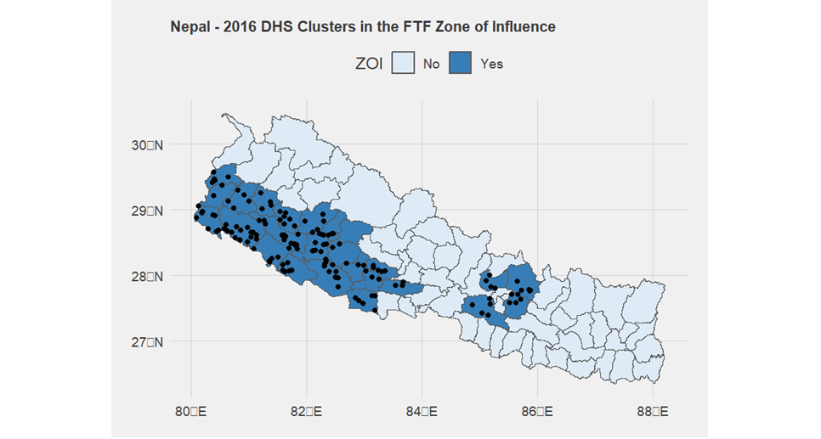
Geospatial Overlay Using R
Notes:
Result of overlay – black dots represent clusters and administrative units in dark blue units represent FTF ZOI. All clusters are located in the ZOI; all others were dropped from the data following the geospatial overlay.

Slide 11
Construction of Indicators
Stunting
Load the household member data file that was created in Section 16.2.1.
Load “[CC]PR[VV]FL_FTF_ZOI.DTA”
Create a variable to indicate whether a child is stunted (chn_stunted).
Create a variable that categorizes children under 5 years of age into two age categories (0-23 months and 24-59 months)
Create a variable that categorizes children under 5 years of age into 12-month age categories (agegrp_cu5_5grp).
After applying the household sampling weight, calculate the percentage of children under 5 years of age who are stunted (de facto household members only).
Notes:
Children with a HAZ score less than -2 (i.e., hc70<-200) are categorized as stunted. Children with a HAZ score determined to be invalid (HAZ score <-6 or HAZ score >+6) or missing (hc70≥9996) are set to missing.
Repeat using the child sex (hc27) and child age category disaggregates (agegrp_cu5_2grp and agegrp_cu5_5grp), as well as the wealth quintile disaggregate (hv270). Note that in DHS datasets, hv005 is the household sampling weight without any decimal places, hv001 is the cluster variable, hv022 is the strata variable, and hv103 is the de facto household member variable. (Sample code uses Stata syntax.)

Slide 12
Construction of Indicators
Wasting
Using the same data file used to calculate the stunting indicator previously, create a variable to indicate whether a child is wasted (chn_wasted).
After applying the household sampling weight, calculate the percentage of children under 5 years of age who are stunted (de facto household members only). Set chn_stunted=0
Notes:
Children with a WHZ score less than -2 (i.e., hc72<-200) are categorized as wasted. Children with a WHZ score determined to be invalid (WHZ score <-5 or HAZ score >+5) or missing (hc72≥9996) are set to missing.

Slide 13
Construction of Indicators
Healthy Weight
Using the same data file used to calculate the stunting indicator in Section 16.2.2 and wasting indicator in Section 16.2.3, create a new variable to indicate whether a child is of healthy weight (chn_hw).
After applying the household sampling weight, calculate the percentage of children under 5 years of age who are wasted (de facto household members only).
Save the data file with the children’s anthropometry variables created.
Notes:
Children with a WHZ score greater or equal to -2 and less than or equal to +2 (i.e., hc72≥-200 and hc72≤+200) are categorized as being of healthy weight. Children with a WHZ score determined to be invalid (WHZ score <-5 or HAZ score >+5) or missing (hc72≥9996) are set to missing.

Slide 14
Construction of Indicators
Underweight Women of Reproductive Age
Load the woman’s data file that was created in Section 16.2.1.
Create a variable that indicates the age of each woman’s youngest child (cage_youngest).
The variable will be used in the next step to exclude women who gave birth to a child during the 2 months preceding the survey from the underweight indicator calculation.
To create cage_youngest, use b19_01 (current age in months of the woman’s youngest child) if it exists in the data file.
Create a variable that indicates whether a woman 15-49 years of age is underweight according to their BMI (BMI<18.5kg/m²) (whn_uw).
Be sure to exclude women who reported that they were pregnant at the time of interview (v213=1) or gave birth to a child during the 2 months preceding the survey (cage_youngest<2).
Notes:
To construct cage_youngest, if b19_01 does not exist, subtract the date of birth of the woman’s youngest child (b3_01) from the date of interview (v008).

Slide 15
Construction of Indicators
Underweight Women of Reproductive Age
Create a variable that categorizes women 15-49 years of age into 5-year age categories (agegrp_wra_7grp).
After applying the women’s individual sampling weight, calculate the percentage of women 1549 years of age who are underweight according to their BMI.
Save the data file with the women’s anthropometry variables created in this section in it.
Notes:
To construct cage_youngest, if b19_01 does not exist, subtract the date of birth of the woman’s youngest child (b3_01) from the date of interview (v008).

Slide 16











U.S. Government Partners
Notes:
Please include this slide in your presentation in the appropriate location. Notes: Feed the Future connects U.S. Government efforts targeted at global hunger and food security. Led by USAID, Feed the Future draws on the resources and expertise of the U.S. Departments of Agriculture, Commerce, State and Treasury; the Millennium Challenge Corporation; the United States African Development Foundation; the Peace Corps; the Overseas Private Investment Corporation; the Office of the United States Trade Representative; and the U.S. Geological Survey.

